Slide 1




Generative Artificial Intelligence
Paul Dubois
Info@Lèze

Slide 2
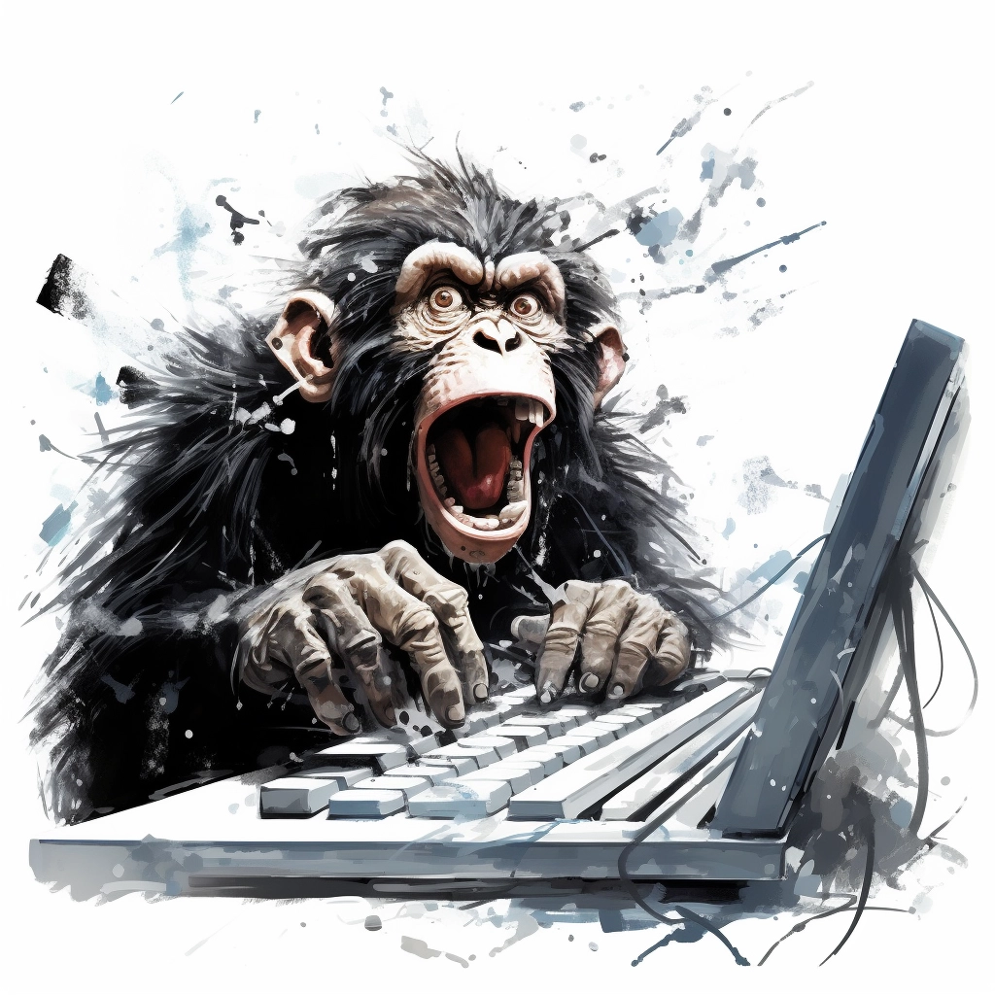
Creating new words

Slide 3
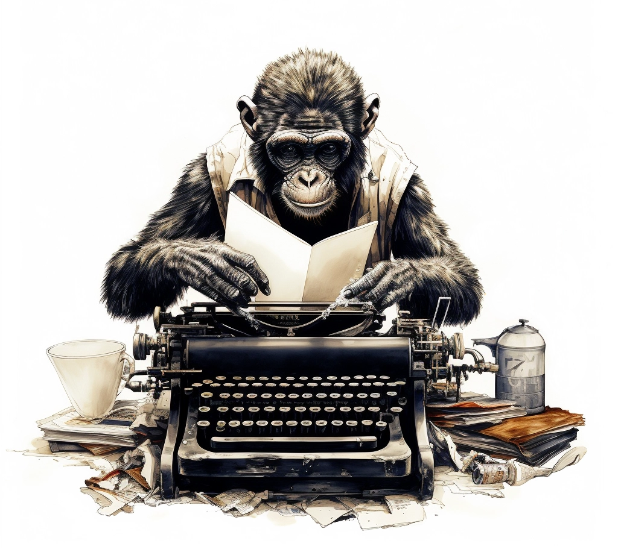
Method 1:
Randomly type on a keyboard

Slide 4
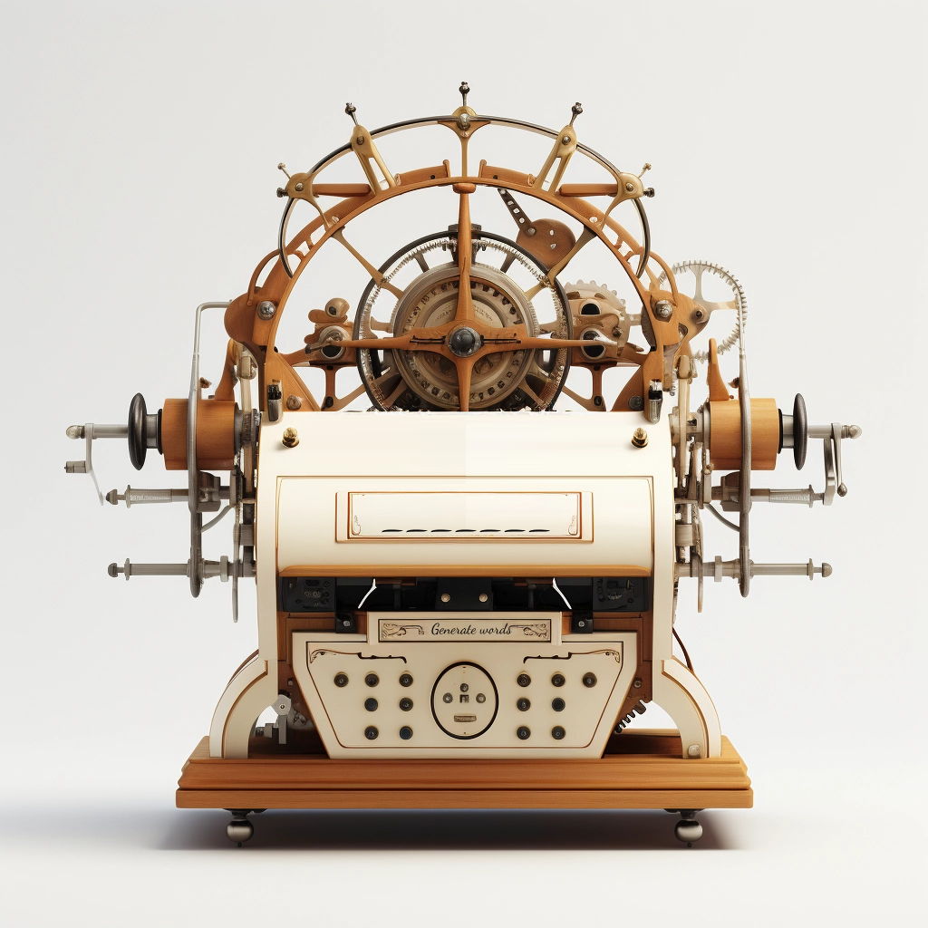
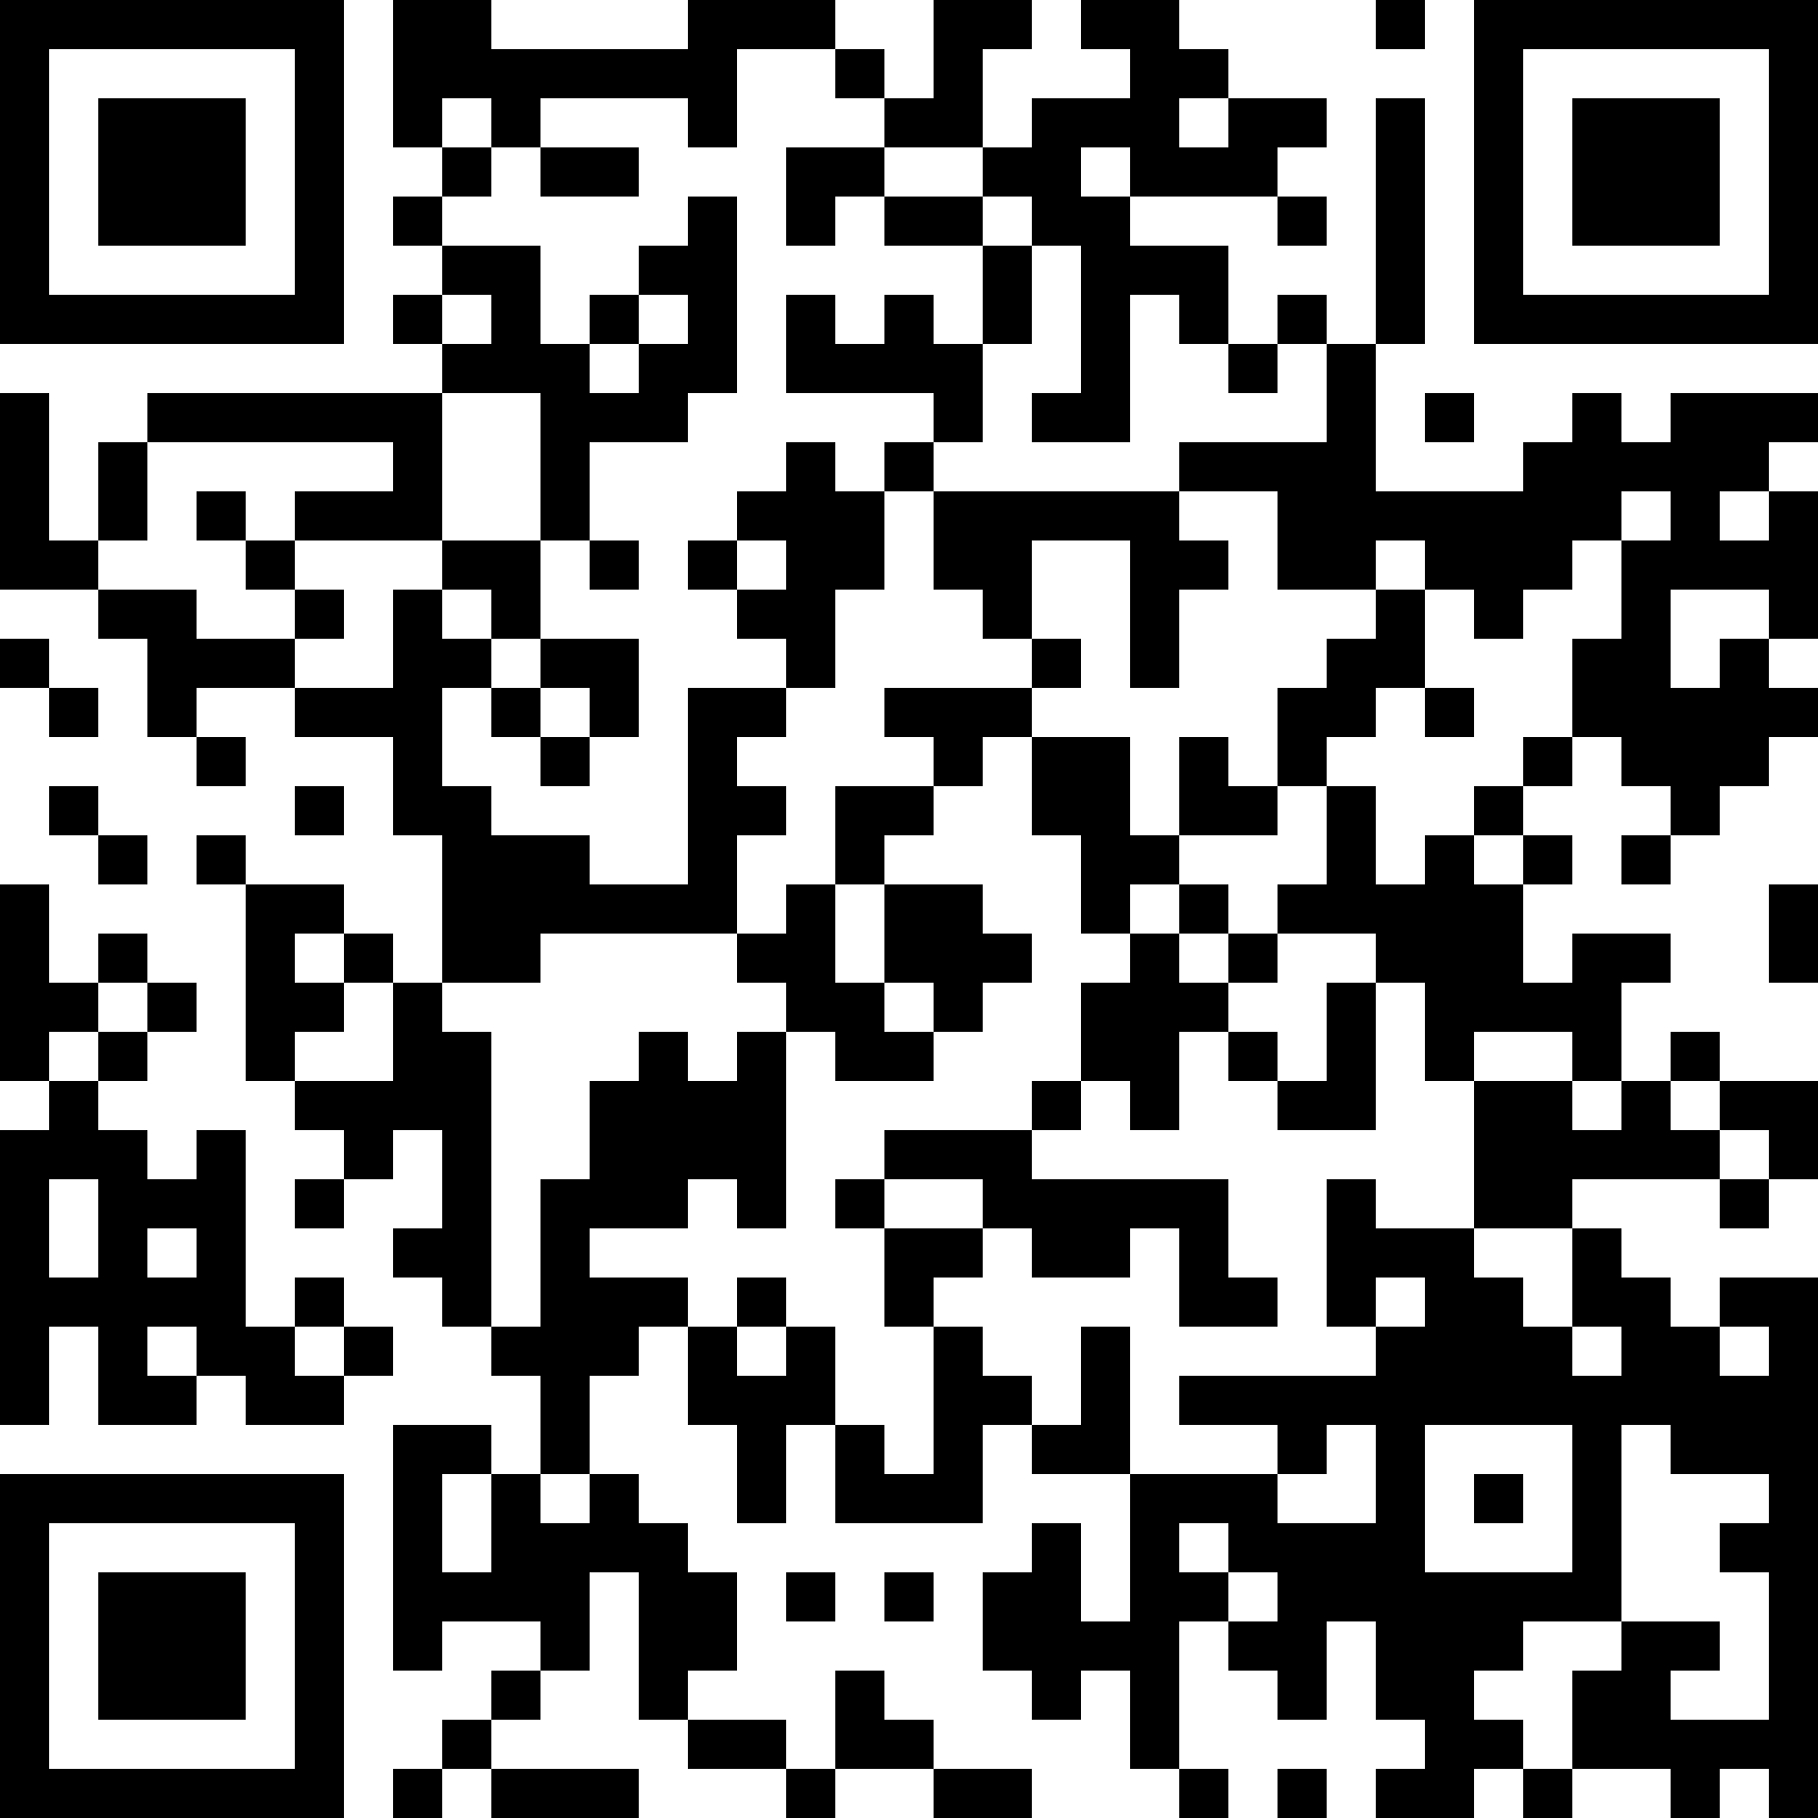
Words Generator Machine 1
https://pauldubois98.github.io/GenerativeAI/word_generator1.html

Slide 5
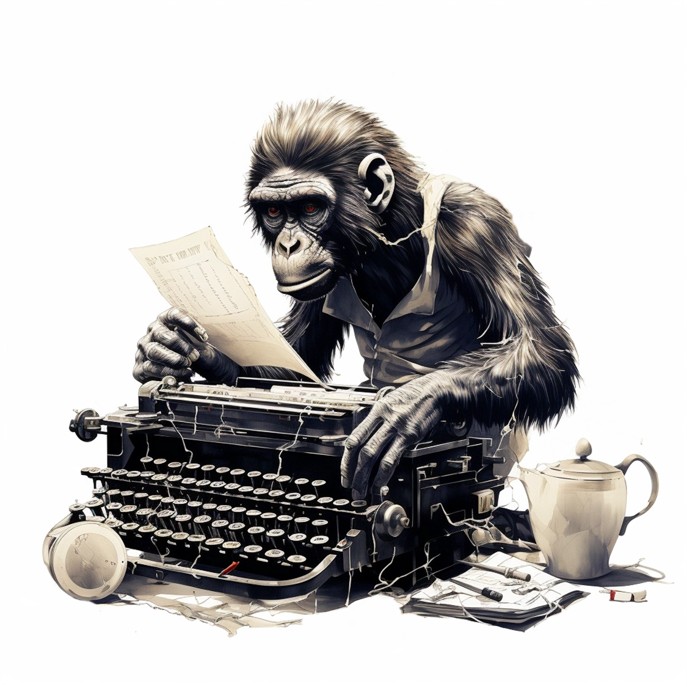
Method 2:
Type on a weighted keyboard

Slide 6
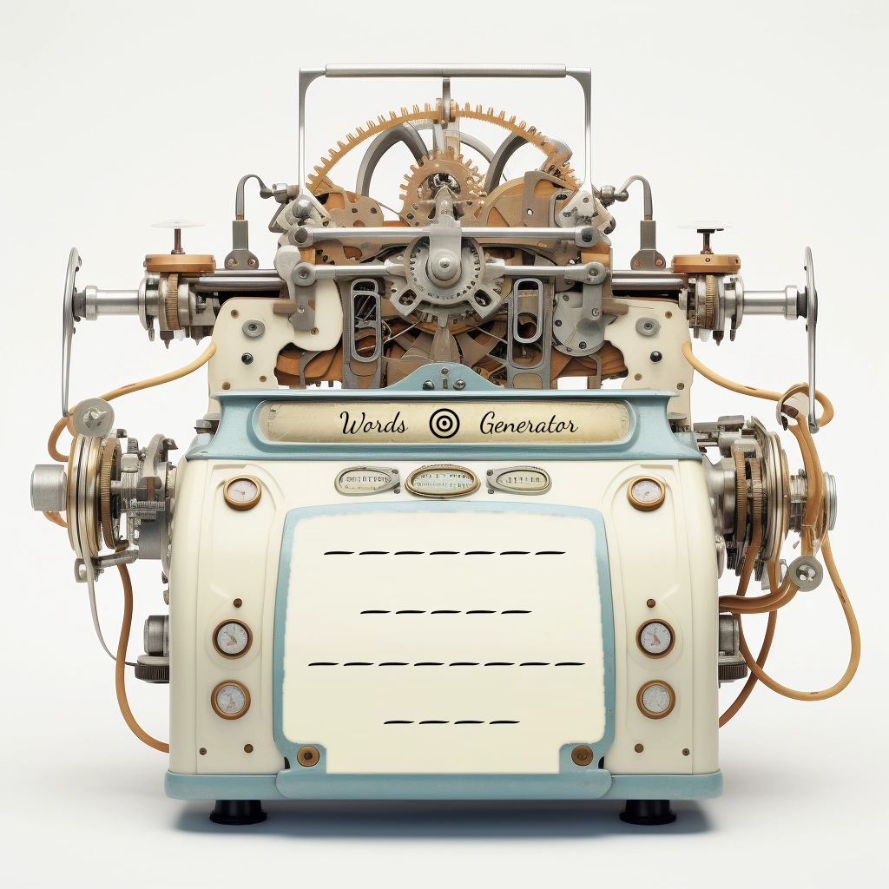
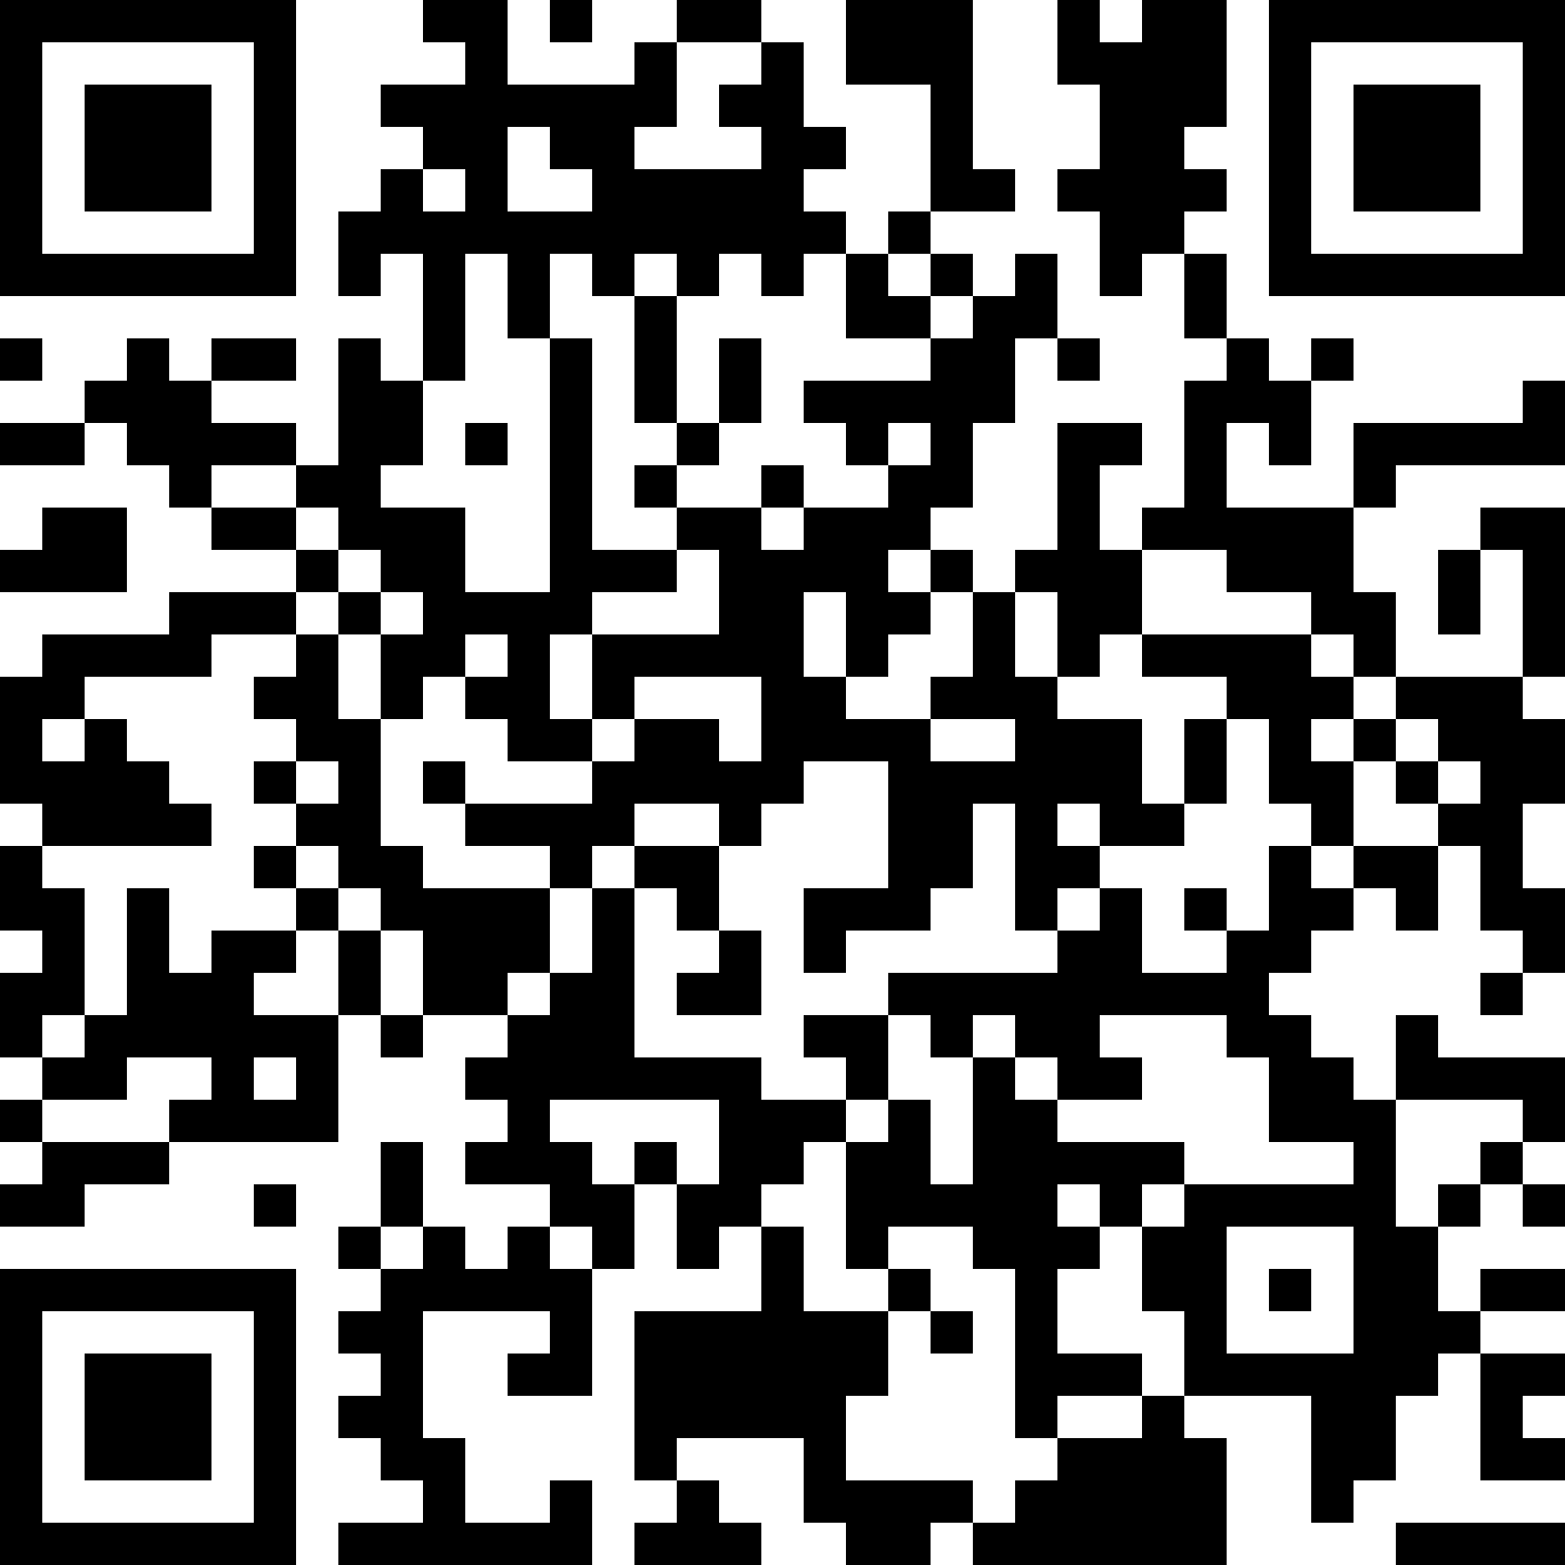
Words Generator Machine 2
https://pauldubois98.github.io/GenerativeAI/word_generator2.html

Slide 7
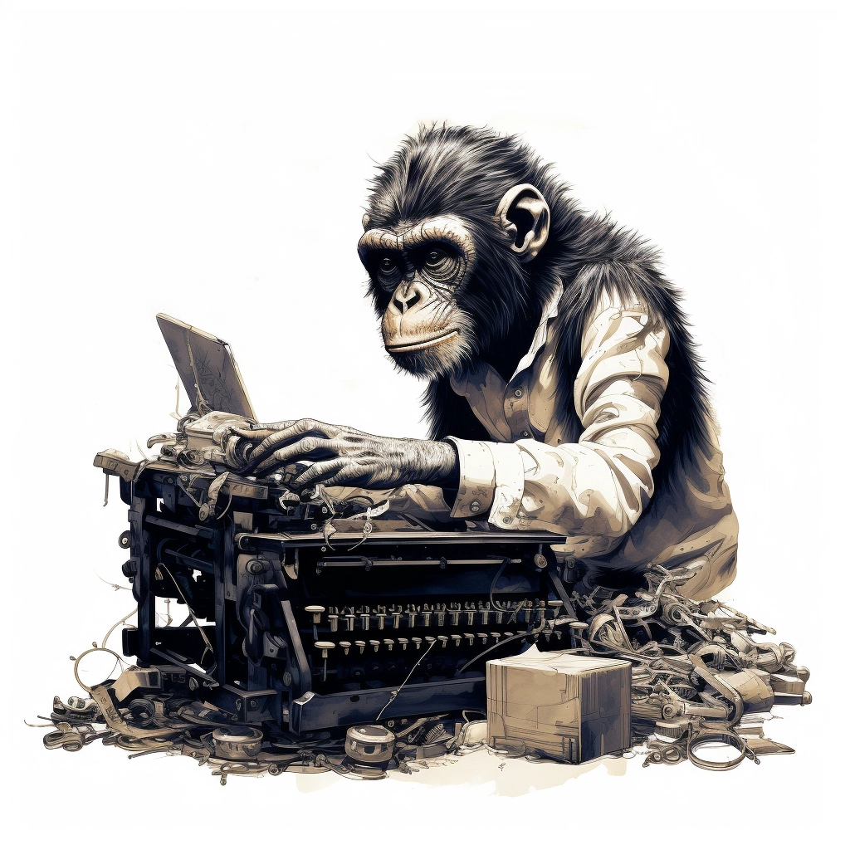
Method 3:
Dynamically weighted keyboard

Slide 8
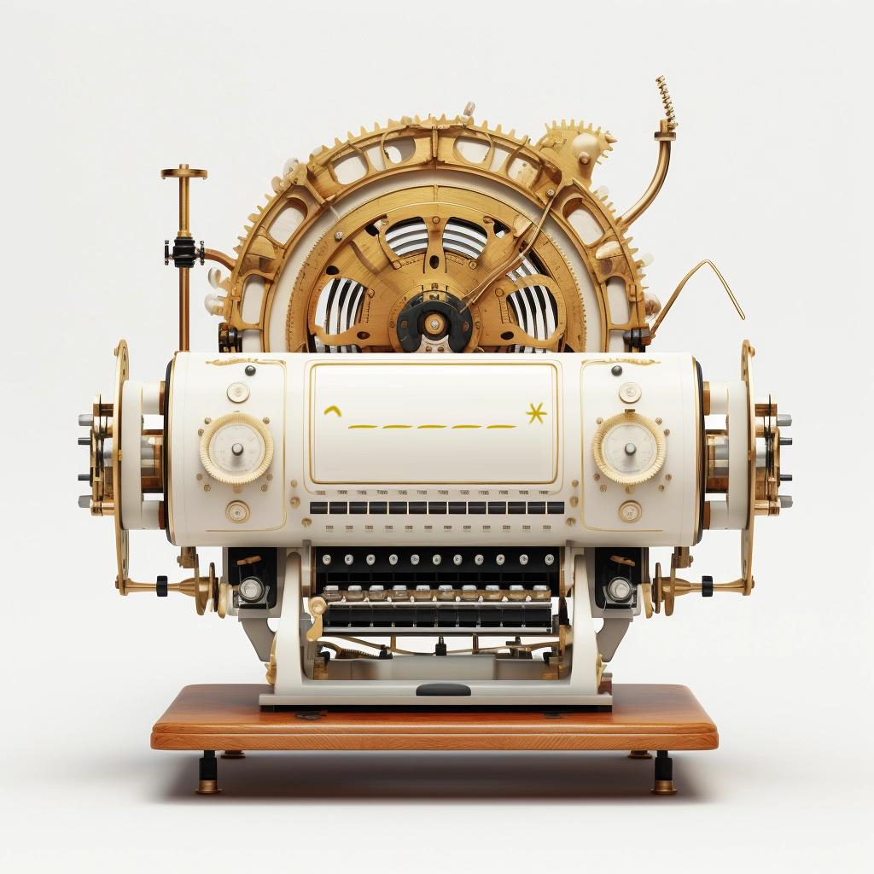
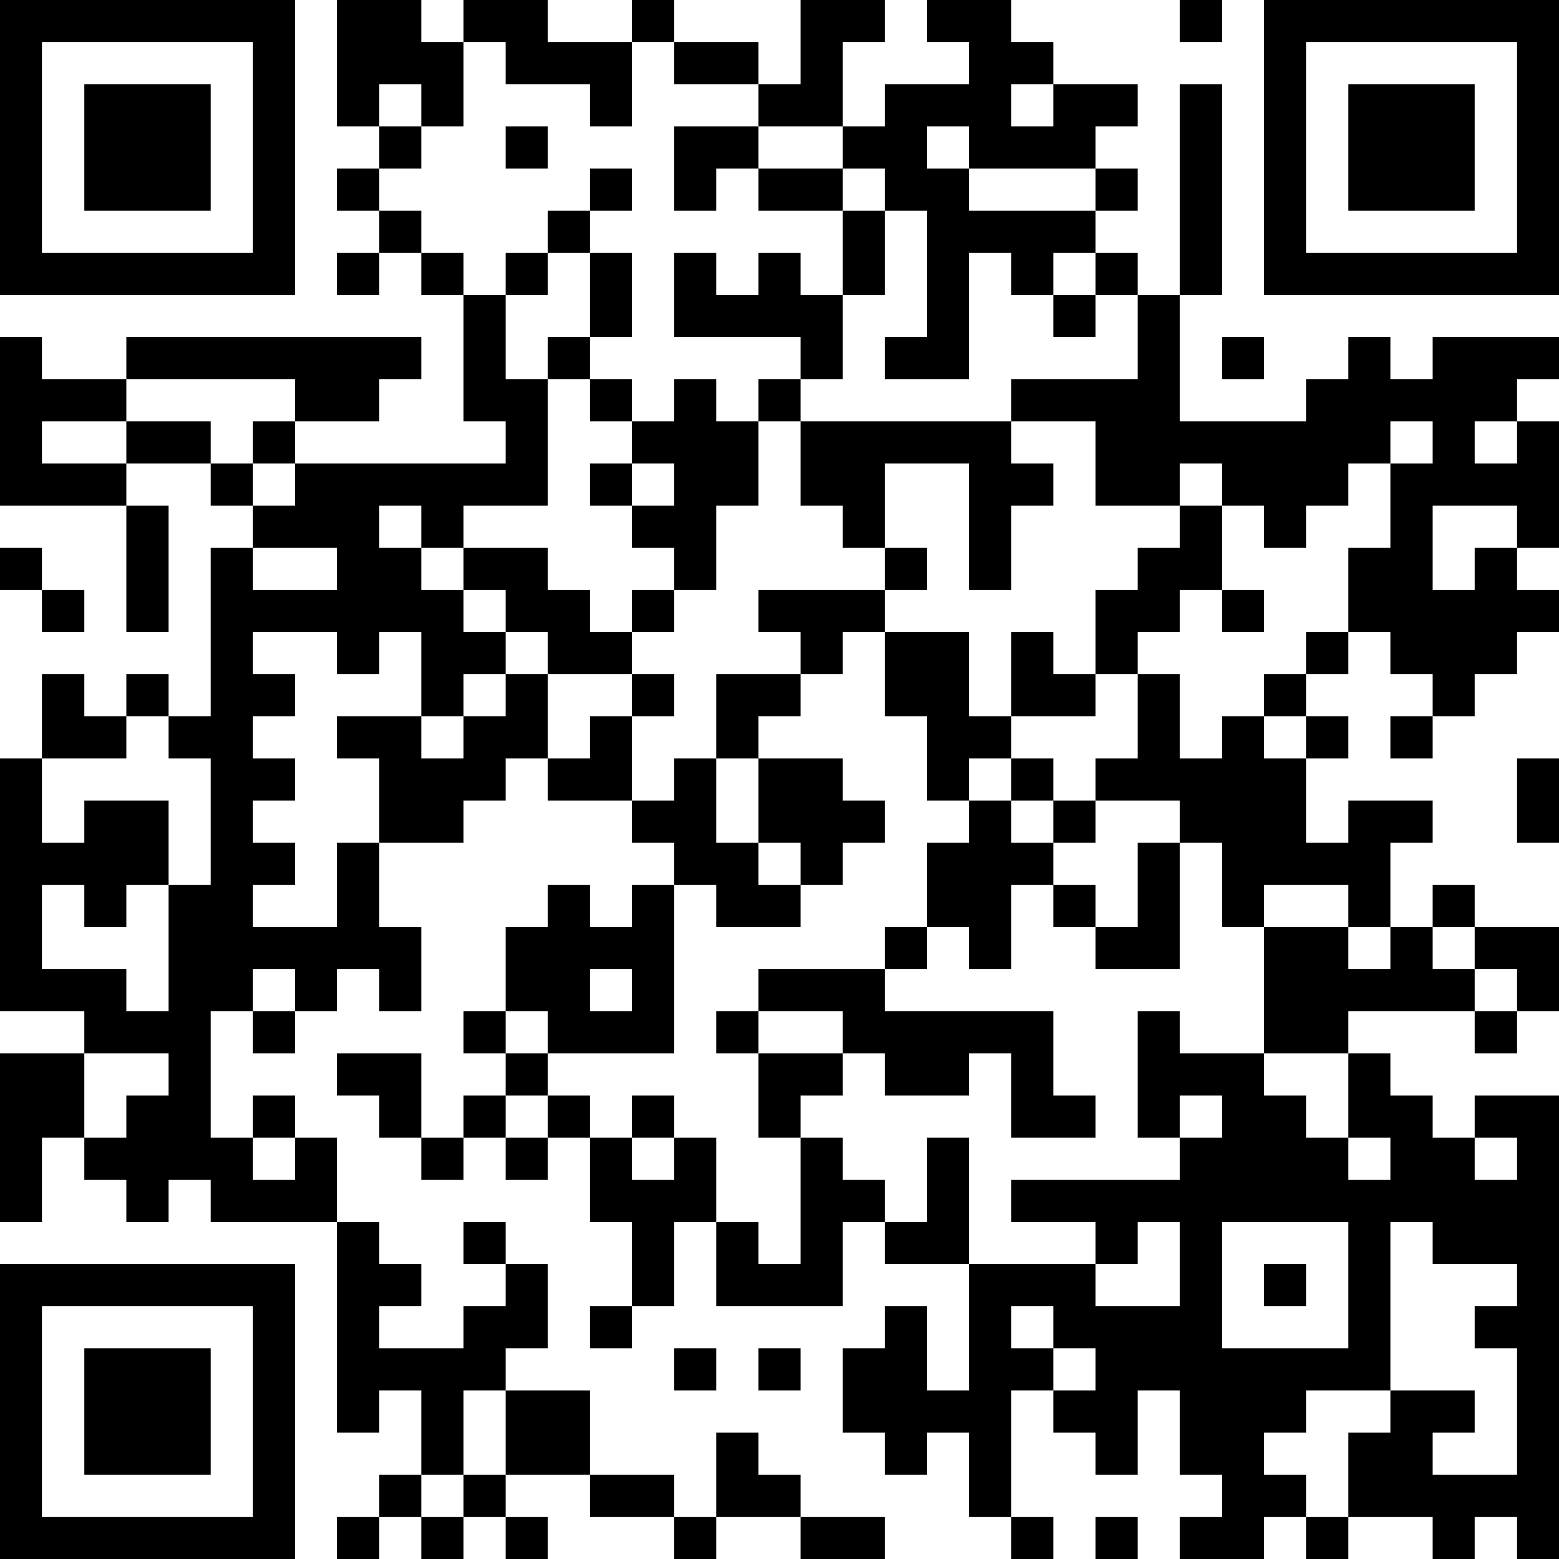
Words Generator Machine 3
https://pauldubois98.github.io/GenerativeAI/word_generator3.html

Slide 9
Predict letters

Slide 10
Generator vs Discriminator

Slide 11
Denoising

